Slide 1
Capstone Final Assignment Analysis of Chicago Neighborhoods
Submitted by Rajaram Challa

Slide 2
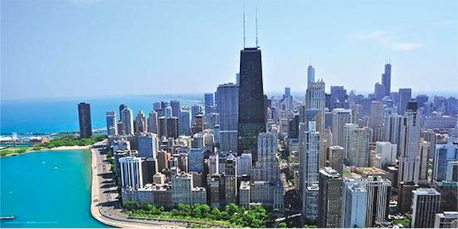

Slide 3
Introduction
People move a lot
Multiple times in their education and career
Often times to a new place with no prior familiarity
Selection of neighborhood should not be purely subjective
Data Science techniques can be used to assist in narrowing down the search

Slide 4
Data
Foursquare venue data (as required by the assignment)
Publicly made available demographic / crime / education data from municipal / state agencies; Examples such as
Chicago Crime Data (from a previous Coursera Course)
Chicago Public School Data (from a previous Coursera Course)
Data from websites such as apartments.com
Additional information on the location of the data sets and the attributes in available in the Reference Section of the Report submitted.

Slide 5
Methodology
Locate and map all the schools in the Chicago area.
Identify schools that meet certain requirements.
Adequate Yearly Progress Made?
High SAFETY_SCORE
High AVERAGE_STUDENT_ATTENDANCE
Analyze socio economic data and identify neighborhoods with a high per-capita income
Choose a high quantile(e.g. cse_sorted_df [‘per_capita_income_’].quantile(0.75)
Use geocoders to obtain longitude and latitude for the selected neighborhoods
Identify and map the locations of crimes (for entire Chicago)
Then focus on neighborhoods of interest
Use Foursquare to locate Apartments and Train Stations
Review the data produced and make it more useful by eliminating irrelevant rows and by correcting minor issues with the data
Map Chicago “L” train stations in the selected neighborhoods
Identify a couple of neighborhoods for further physical exploration

Slide 6
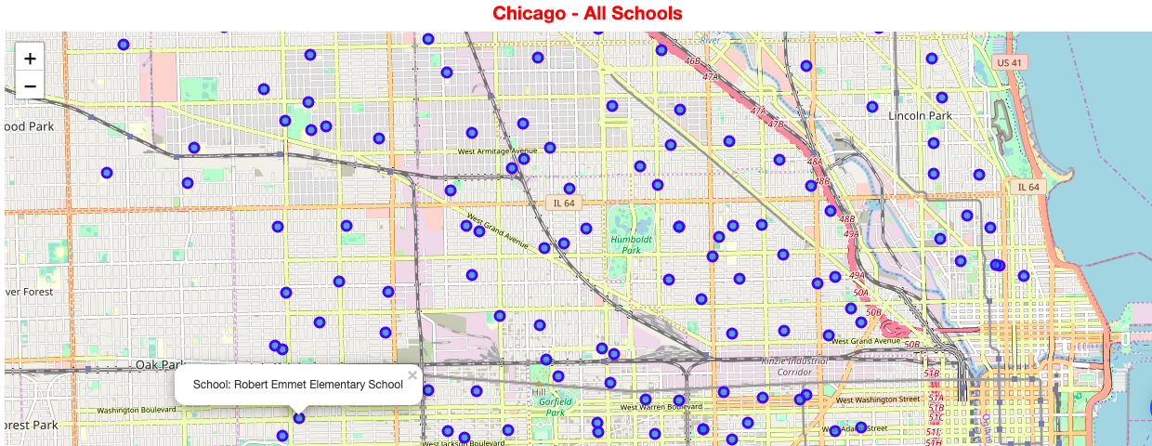
Results - All Schools

Slide 7
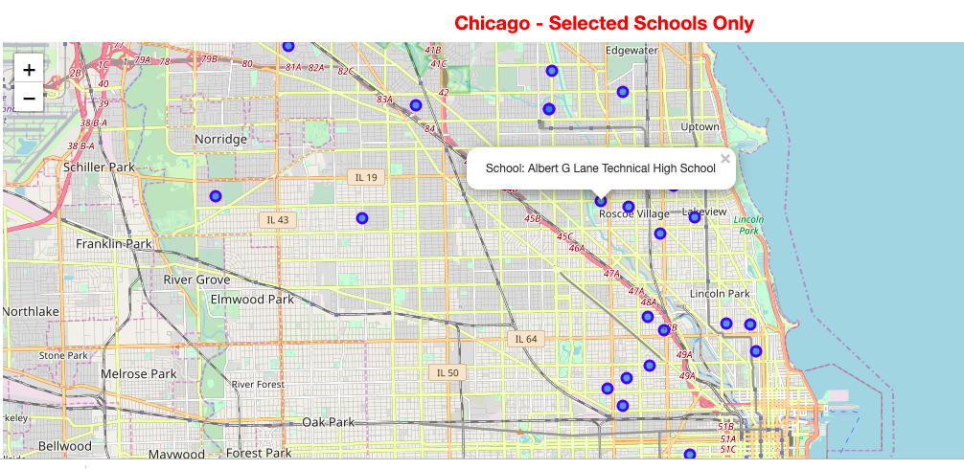
Results – Filtered Schools

Slide 8
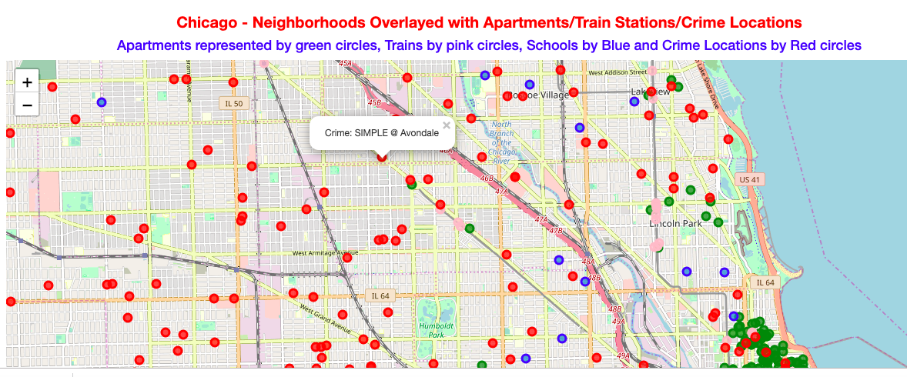
Results – Crimes In Chicago

Slide 9
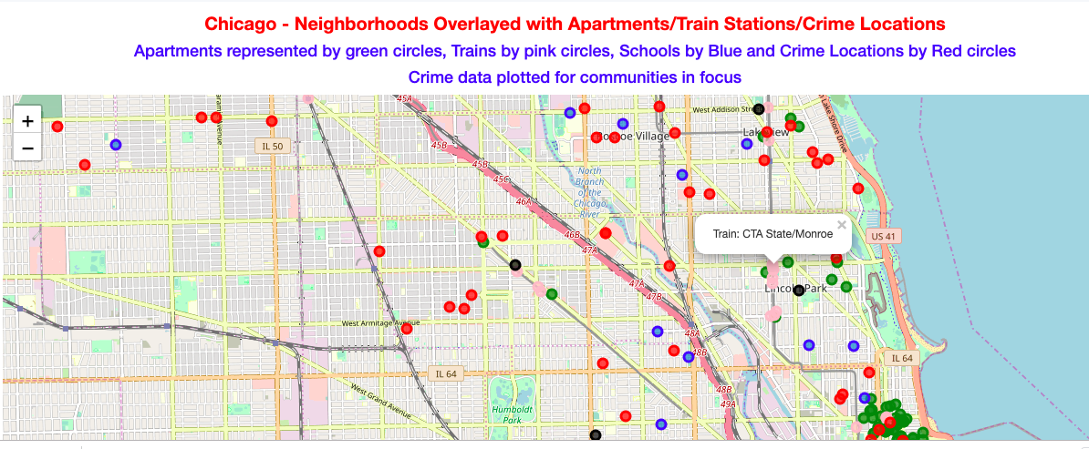
Results – Crimes In Selected Neighborhoods

Slide 10
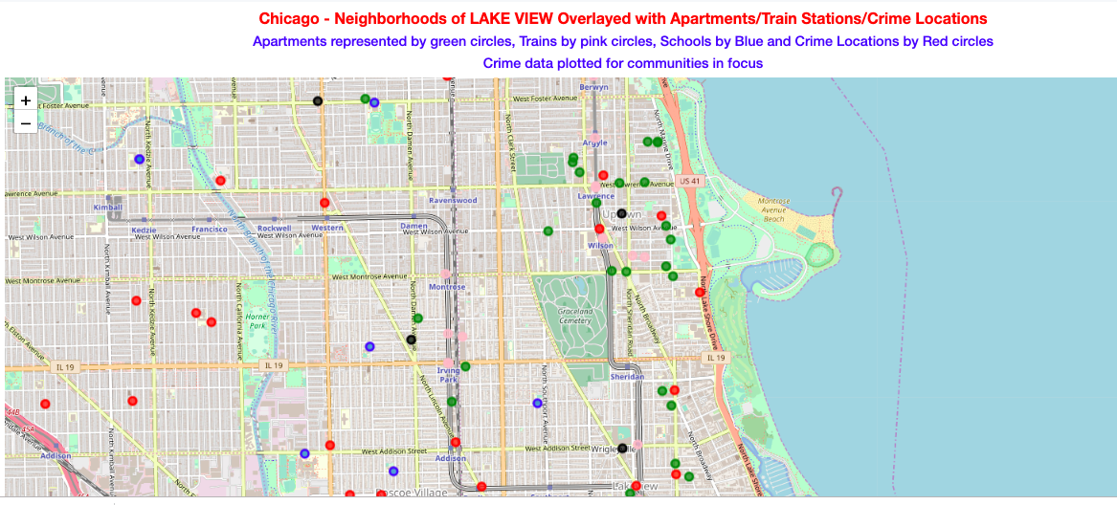
Investigate Further – Lake View

Slide 11
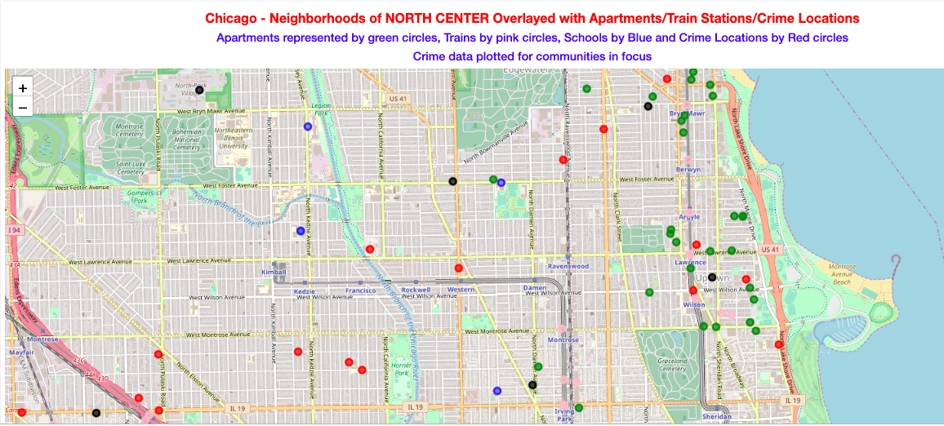
Investigate Further – North Center

Slide 12
Conclusion
Hyde Park, Edison Park and Norwood Park, North Center and Lake View neighborhoods deserve further investigation

Slide 13
Next Steps
Please view the entire Notebook at
https://github.com/RajaramChalla/TorontoClusters/blob/master/Capstone_Final_Assignment%20-%20Chicago%20Neig.ipynb
Please Please use nbviewer to view the Notebook
https://nbviewer.jupyter.org/ Paste the above Notebook link into the text box on this viewer web page.
The full report is available at
https://github.com/RajaramChalla/TorontoClusters/blob/master/Capstone_Project_Final_Assignment_Report_by_Rajaram_Challa.docx
The pdf version is at: https://github.com/RajaramChalla/TorontoClusters/blob/master/Capstone_Project_Final_Assignment_Report_by_Rajaram_Challa.pdf

